Slide 1
A BLE-based multi-gateway network infrastructure with handover support for mobile BLE peripherals
SPEAKER : Jia-Wei Guo
ADVISOR: DR. HO-TING WU
Date: 2020/09/30

Slide 2
Outline
Introduction
Primer on BLE and BLE over IPv6
A BLE-based multi-Gateway network infrastructure
Handover approaches
Implementation details
Evaluation
Conclusion
References

Slide 3
Introduction
Bluetooth Low Energy (BLE) is a popular technology within the Internet of Things. It allows low-power, star networks to be set up between a BLE gateway and multiple , power-constrained BLE devices.
However, these networks tend to be static, not supporting BLE devices that can freely move around in an environment of multiple interconnected BLE gateways and perform handovers whenever necessary.

Slide 4
Introduction(cont’d)
This research proposes two alternative network architectures for mobile BLE peripherals. One leverages on IPv6 over BLE, whereas the other combines default BLE mechanisms with an additional custom controller.
On top, this team studies in detail the handover mechanism that must be present in both architectures and compare the performance of both a passive and active handover approach.

Slide 5
Primer on BLE and BLE over IPv6
Bluetooth Low Energy (BLE) was released in 2011 as part of the Classic Bluetooth specification and both technologies have coexisted and evolved independently since then.
BLE operates in the 2.4 GHz band, utilizing frequencies between 2402 and 2480MHz. The used spectrum is divided into 40 channels, each employing a space of 2 MHz. These channels are divided into 3 primary advertisement channels and 37 connection-oriented channels.
BLE supports two different ways of communication : an advertising mode and a connection-oriented mode.

Slide 6
Primer on BLE and BLE over IPv6(cont’d)
In advertising mode , a device can either be in an advertising or scanning state. A BLE advertiser broadcasts advertisement packets on the 3 advertisement channels sequentially, at a certain interval. A BLE scanner scans one of these advertisement channels.

Slide 7
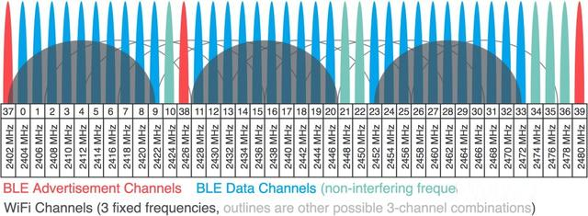
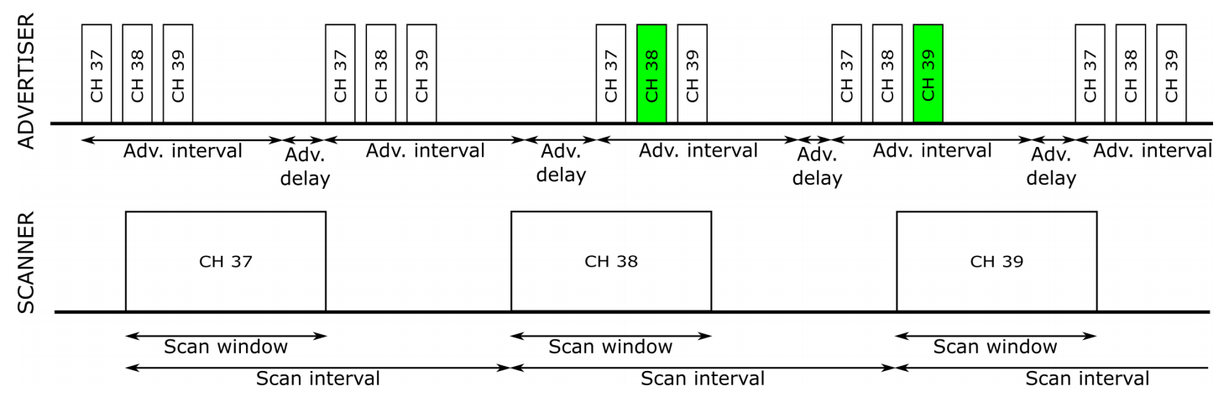
Primer on BLE and BLE over IPv6(cont’d)
Channels
advertising mode

Slide 8
Primer on BLE and BLE over IPv6(cont’d)
In connection-oriented mode, one device acts as a BLE central and the other device acts as a BLE peripheral.
The devices communicate within connection events, at a certain interval and initiated by the central.
Use Frequency-hopping spread spectrum(FHSS) and Time division multiple access(TDMA) to communicate.

Slide 9
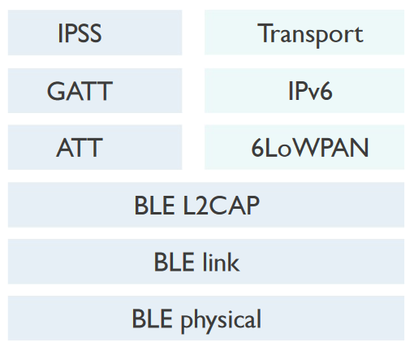
Primer on BLE and BLE over IPv6(cont’d)
About BLE over IPv6.
It exploits the existing BLE stack layers and adds a 6LoWPAN layer between the BLE layers and the IP layer.

Slide 10
Primer on BLE and BLE over IPv6(cont’d)
The BLE central acts as 6LoWPAN border router (6LBR) and one or more BLE peripherals as 6LoWPAN nodes (6LN), resulting in an isolated IPv6 over BLE subnet.
The 6LoWPAN border router can also be connected to the Internet, ultimately allowing end-to-end IPv6 connectivity between a BLE peripheral and any application server on the Internet.

Slide 11
A BLE-based multi-Gateway network infrastructure
For the design of our BLE-based multi-GW network infrastructure, this research considers two variants.
Further called IP and non-IP, should be able to achieve seamless handover within the network of IoT gateways.

Slide 12
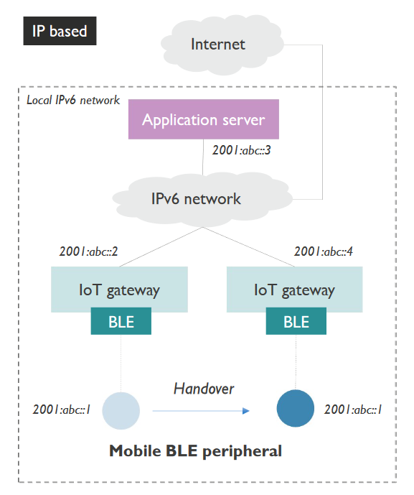
IP based architecture
BLE peripheral. The BLE peripheral needs to mold its native BLE stack in order to support IPv6 over BLE.
The peripheral generates a link-local address derived from the device’s BLE MAC address and a global IPv6 address based on a common prefix.
In order to move around inside a network of IoT GWs and perform handovers, the peripheral should always be in one of two states:
a) in connection with an IoT GW
b) advertising its presence to nearby IoT GWs using BLE advertisements.

Slide 13
IP based architecture(cont’d)
The IoT GW should be able to support theIPv6 over BLE stack, while at the same time taking on the role of IPv6 router and neighbor proxy towards the existing IPv6 network.
The peripheral acquires a global IPv6 address usable within the IPv6 network, stateless address autoconfiguration is used.

Slide 14
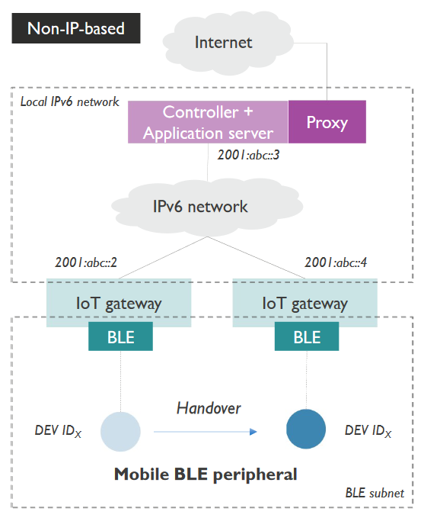
Non-IP based architecture
As no IP is used , to set up IoT connectivity between the BLE peripheral and the controller, no extra implementation is needed on the peripheral apart from setting up native BLE communication.
In order to achieve seamless handover, the peripheral is in one of two states at all times:
a) in a BLE connection with an IoT GW,
b) advertising its presence using BLE advertisements.

Slide 15
Non-IP based architecture(cont’d)
IoT gateway , The gateway should expose the BLE peripheral towards the IP network in an application agnostic way.
the IoT GW only has a forwarding role and is unaware of the application layer connectivity between the BLE peripheral and the controller.

Slide 16
Non-IP based architecture(cont’d)
Controller.
The IoT GWs notify the controller when a new connection is established or a disconnection occurs.
Therefore,the controller should keep a mapping table, linking each BLE peripheral to its current corresponding IoT GW.
The peripherals are identified via an implementation specific device ID. To expose the BLE peripheral to the Internet, the controller could act as a proxy or bridge, hereby translating the application layer to another protocol.

Slide 17
Handover approaches
About passive handover:
A BLE connection is terminated naturally after the supervision timeout has timed out. Only then, the BLE peripheral attempts to set up a new connection by advertising its presence using BLE advertisements.
When using the passive handover approach, a connection to a new and better GW will only be established when the previous connection was completely broken, i.e. when no traffic could be sent during the supervision timeout range.
As such, it might happen that a peripheral remains connected even when the link quality becomes very poor.

Slide 18
Handover approaches(cont’d)
About active handover :
The BLE peripheral maintains an advertiser role at all times.
The IoT GWs use these periodic BLE advertisements to derive a Received Signal Strength Indicator (RSSI).

Slide 19
Handover approaches(cont’d)
All collected RSSI values are forwarded to the controller.
The controller maintains a mapping table between the received RSSI values and the associated IoT GW and BLE peripheral.
Concurrently, this mapping table is used to monitor the current state of the BLE connections and decides whether a specific BLE peripheral should handover to another IoT GW.

Slide 20
Handover approaches(cont’d)
Such a handover decision is taken when two conditions are met: the connection to the current IoT GW is bad and a sufficiently good enough alternative IoT GW is available.
The connection can be considered bad once the RSSI exceeds a certain RSSI threshold, meaning that the peripheral is not too far from the GW for the connection to be lost, but far enough to be of insufficient quality.
Another GW can be considered a sufficient alternative, once its RSSI exceeds a certain threshold as well, indicating that the peripheral is actually close enough to that GW to establish a connection of sufficient quality.

Slide 21
Handover approaches(cont’d)
When a handover decision is made, a disconnect message is sent by the controller to the old IoT GW and a connect message to the alternative IoT GW.
The old IoT GW forwards this request to the BLE peripheral and the peripheral immediately terminates the connection (independent of the supervision timeout).
Afterwards, the BLE advertisements can be answered with a connection request again, which is now done by the alternative gateway incited by the connect message.

Slide 22
Handover approaches(cont’d)
On top, when a BLE peripheral does not yet have a BLE connection with an IoT GW, the current best RSSI is can be used to find a suitable IoT GW and set up the connection.
When an IoT GW naturally loses a BLE connection, which can occur if no suitable alternative was available, or a BLE connection failed to be set up, the controller is also notified, such an event indicates that the BLE peripheral has moved out of range of the BLE-enabled infrastructure or the infrastructure contains a blind spot.

Slide 23
Implementation details
The BLE peripheral’s role is enacted using a nRF52840 board and the other roles(GW,Controller) are enacted using Raspberry PI’s.
nRF52840 board is capable of implementing a complete BLE v5.0 supported stack as well as the IPv6 over BLE stack adjustment.
Use official Linux Bluetooth protocol stack(BLueZ) on Raspberry Pi.
To emulate a mobile BLE peripheral performing a handover from one gateway to another gateway, in a controller manner, a manual attenuator is used.

Slide 24
Evaluation
The performance of the handover process is predominantly impacted by two steps: disconnecting from the current GW and setting up a connection with the alternative GW.

Slide 25

Evaluation : passive handover
About disconnecting from current GW
The supervision timeout should not be too low , to avoid unnecessary triggering of the handover procedure.
However , a too high supervision timeout can have a significant impact on the handover latency.
According to the BLE standard, Supervision timeout should be larger than
$$(1+slave latency) ∗ connection interval$$
Notes:
Paper的公式是錯的。

Slide 26
Evaluation : passive handover(cont’d)
About setting up a connection with the alternative GW
Once the BLE peripheral’s supervision timeout has timed out, it transitions back to the advertising state, broadcasting connectable advertisements at a certain advertising interval.
A GW that is not in a connection or still has room for another BLE connection, is in the initiating state and attempts to set up a connection upon receiving the connectable advertisements from the BLE peripheral.

Slide 27
Evaluation : passive handover(cont’d)
About BLE parameter combinations
The advertising interval should be smaller or equal to the scan window, because otherwise it cannot be guaranteed that the GW will be able to receive a connectable advertisement in an acceptable time window.
A higher scan duty cycle ( scan window/scan interval ) has a positive impact on the handover latency but a negative impact on the energy consumption of the GW.
Notes:
但使用連續scan可降低外圍設備的功耗，因為可較快接收到advertising。

Slide 28
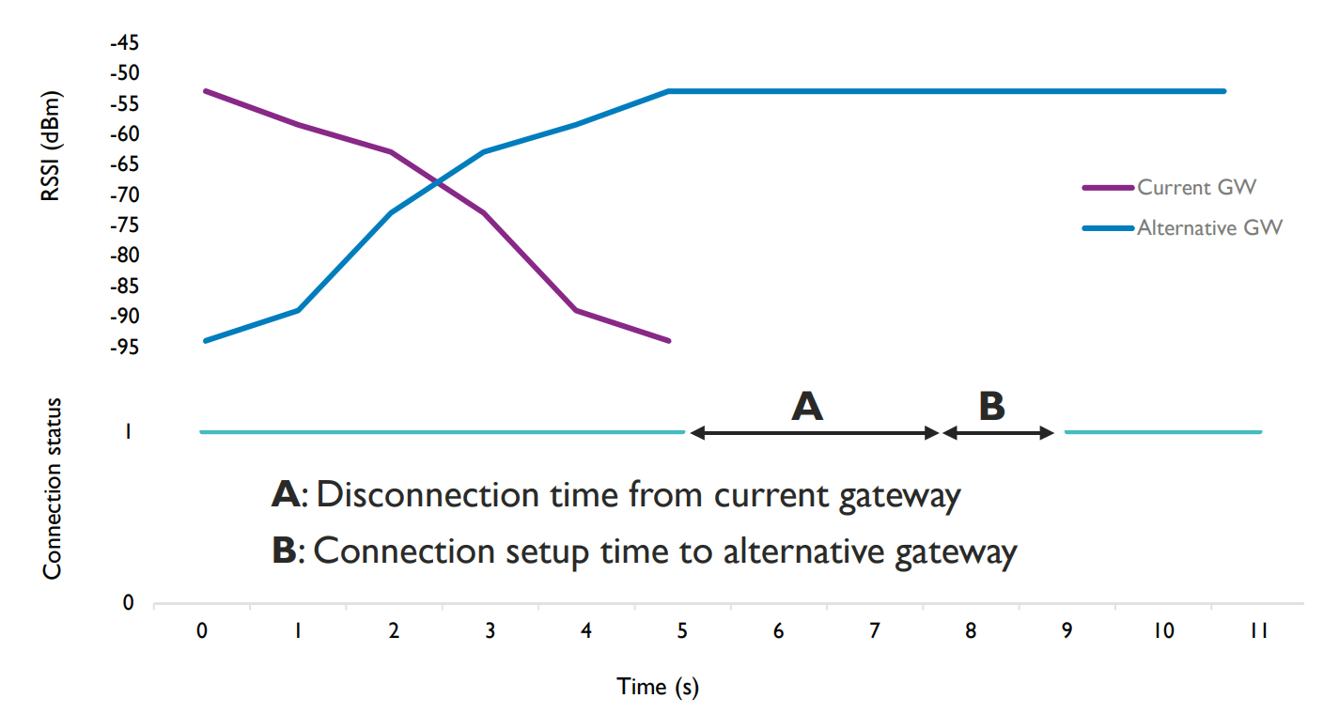
Evaluation : passive handover(cont’d)

Slide 29
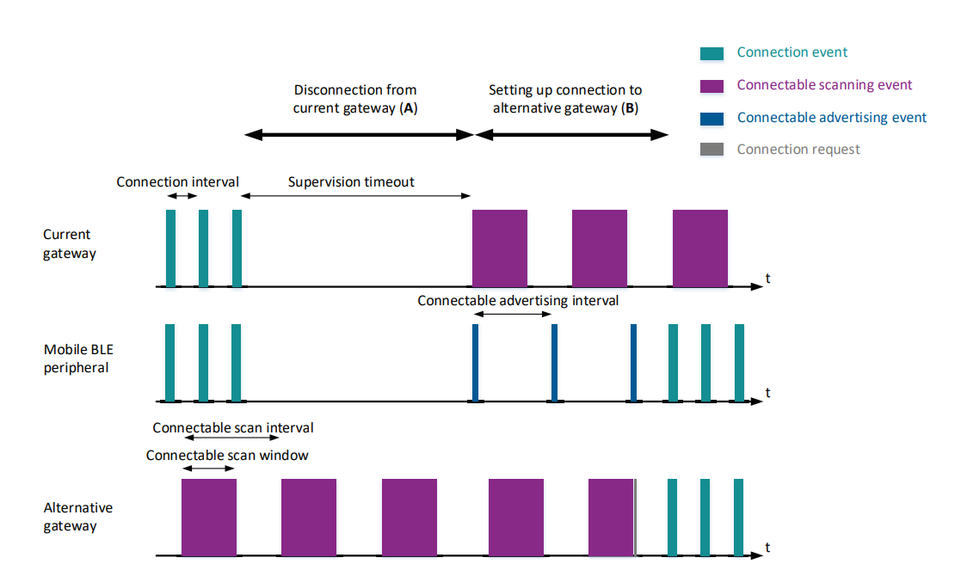

Slide 30
Evaluation : active handover
About disconnecting from current GW
the current GW will receive a disconnection message from the controller once a roaming decision has made.
After receiving this message, the GW immediately attempts to send a disconnection request to the BLE peripheral.
Upon receiving this request, the peripheral answers with a disconnection acknowledgment.

Slide 31
Evaluation : active handover(cont’d)
About Setting up a connection with the alternative GW
Once the disconnection has been finalized, the BLE peripheral switches from a connection/advertising state to solely an advertising state, broadcasting connectable advertisements.
In the meantime, the alternative GW has received a connect message from the controller and has switched from nonconnectable to connectable scanning, specifically for the MAC address of the BLE peripheral at hand.
From this point, the handover process is similar to passive handover.

Slide 32
Evaluation : active handover(cont’d)
Potential Optimizations
The BLE peripheral constantly needs to advertise , This increases energy consumption and decreases the quality of the BLE connection as well.
A possible improvement could employ a proactive decision on when to start and stop advertising. The peripheral can monitor the quality of the current connection (i.e. via RSSI) and decide via these indicators whether it is necessary to advertise its presence or not.

Slide 33
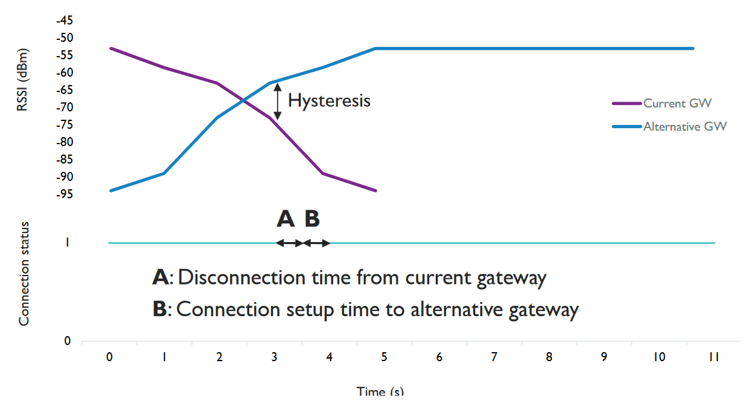
Evaluation : active handover(cont’d)

Slide 34
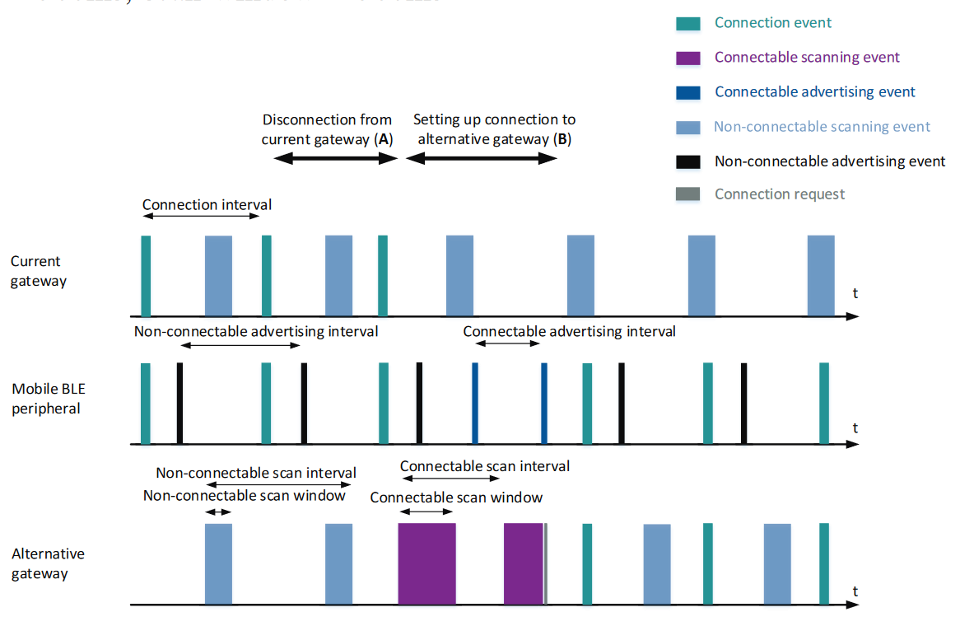
Notes:
Disconnection要先傳資料給外圍設備通知他斷線。

Slide 35
Evaluation(cont’d)
During a handover process, the BLE peripheral is not reachable from application servers. This implies possible data loss.
The newest BLE standard allows a BLE peripheral to be in a connection with multiple BLE centrals at once.
Allowing the current GW to keep its connection with the BLE peripheral, until the new connection with the alternative GW is established.

Slide 36
Evaluation(cont’d)
Finally, to avoid constant switching between connectable and non-connectable scanning, two separate BLE modules could be used on the same GW.
One module is in charge of connectable scanning and maintains existing BLE connections.
The other module performs only non-connectable scanning, continuously sending RSSI log messages to the controller.

Slide 37
Conclusion
In this research, two architectures are proposed to realize a BLE-based multi-GW network infrastructure that is able to provide bidirectional connectivity to mobile BLE peripherals.
The IP based architecture offers seamless end-to-end IP connectivity between a mobile BLE peripheral and an existing IP network. It limits custom implementation needs, but requires more resources from the already constrained mobile BLE peripheral.

Slide 38
Conclusion(cont’d)
The non-IP based architecture requires less resources from the BLE peripheral as it employs native BLE communication towards the IoT gateway.
However, custom implementation needs are much higher, as a dedicated controller is introduced within the existing network that needs to maintain the state of the infrastructure and the currently associated mobile BLE devices.

Slide 39
Conclusion(cont’d)
Next to this, two approaches are considered to perform handover within these solutions.
The passive handover approach does not need any extra implementation, but the handover latency can become quite high and a bad BLE connection is still maintained even if a better alternative GW is available nearby.

Slide 40
Conclusion(cont’d)
Active handover offers a solution by proactively terminating a bad connection when a better alternative GW is available. As such, it can limit the handover latency.
As a downside, this approach requires more extensive custom implementation, implies a higher energy consumption and can limit the available throughput.

Slide 41
References
Mathias Baert, Pieterjan Camerlynck, Pieter Crombez, Jeroen Hoebeke, “A BLE-Based Multi-Gateway Network Infrastructure with Handover Support for Mobile BLE Peripherals” in IEEE Internatonal Conference on Mobile Adhoc and Sensor Systems (IEEE MASS 2019) , DOI: 10.1109/MASS.2019.00020
M. Nikodem, M. Bawiec, “Experimental Evaluation of Advertisement-Based Bluetooth Low Energy Communication”, MDPI Sensors 2020, DOI:10.3390/s20010107
Tomohiro Kuroda, Haruo Noma, Kazuhiko Takase, Shigeto Sasaki, Tadamasa Takemura, “Bluetooth Roaming for Sensor Network System in Clinical Environment” , MEDINFO 2015: eHealth-enabled Health, DOI:10.3233/978-1-61499-564-7-198

